Slide 1

Transformers
Prof. Jeff Byers
EXPLORING GPT-2 AS A DYNAMICAL SYSTEM
Laura Schulze
Savina Tsichli
Maryam Gholami Shiri
Muhammad Usama Qasim

Slide 2
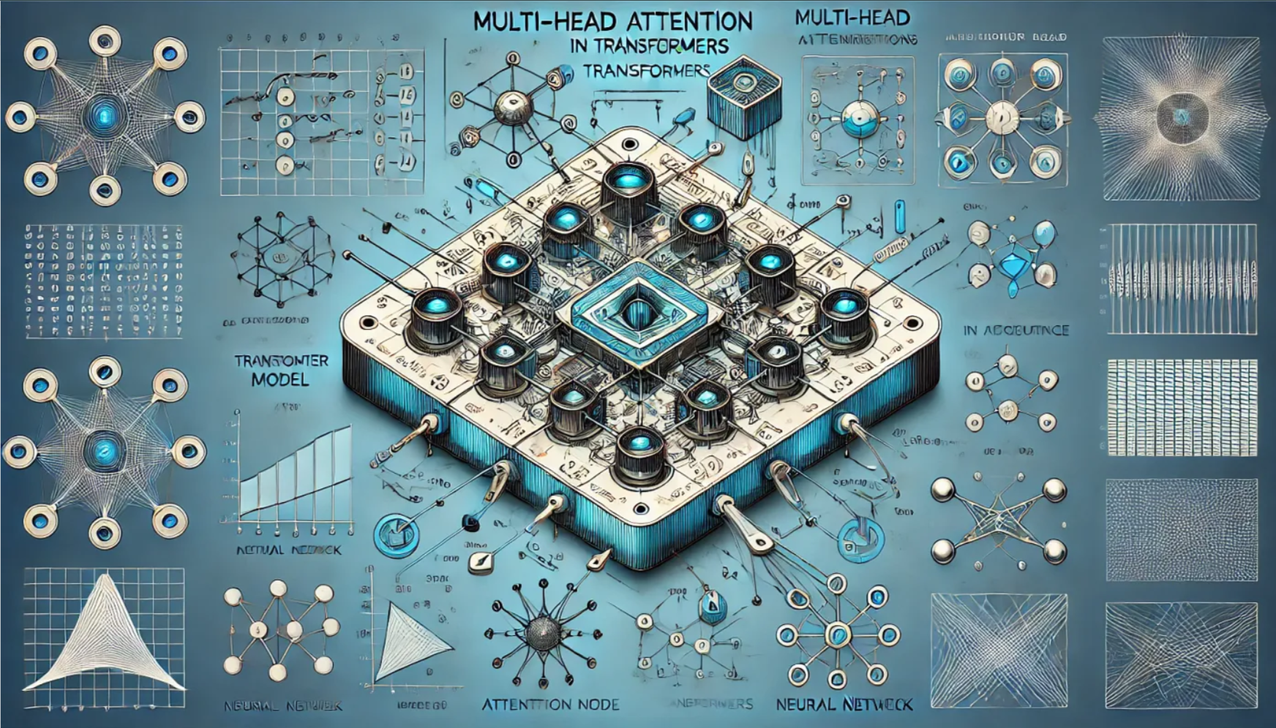

Slide 3
Contents
Theoretical Background
Technical Approach
Token representations
Next Token prediction
Results & Conclusions
Token representations
Next Token prediction

Slide 4
Theoretical Background
Attention Mechanism
Positional Encoding
Parallelization and Efficiency
Scalability and Performance

Slide 5
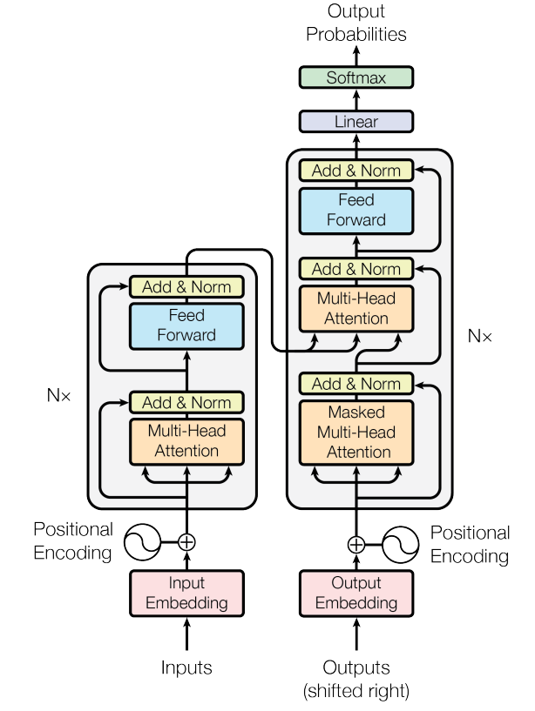
Transformer Model Architecture
The Transformer model uses an Encoder-Decoder structure for sequence-to-sequence tasks:
Input Embedding
Positional Encoding
Encoder
Multi-Head Attention
Add & Norm
Feed Forward
Output Embedding
Decoder
Masked Multi-Head Attention
Multi-Head Attention
Add & Norm
Feed Forward
This architecture efficiently learns complex dependencies, making it ideal for tasks like machine translation.
Notes:
I think this falls in the technical approach - No, I think this is theory and background. In technical approach I talk about what *we* did, what kind of analyses we conducted and how etc., not about how Transformers work in general.

Slide 6
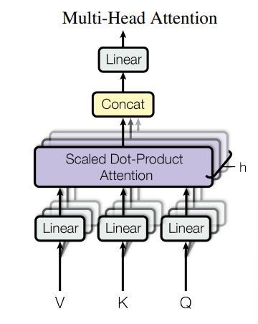
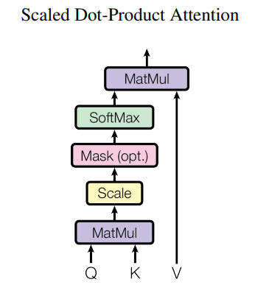
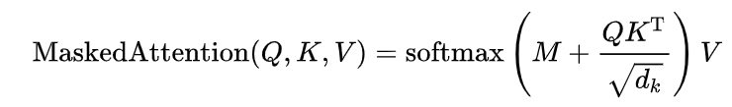

Slide 7
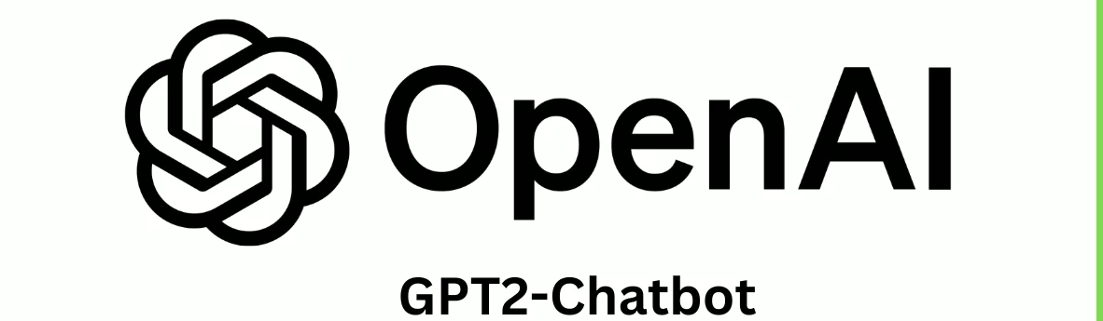
GPT-2 (small)
Vocabulary Size: 50,257 tokens
Structure: 12 Decoder Blocks, Multi-Head Attention
Publication Date: 2019
Training Data: Diverse Internet Text (WebText)

Slide 8
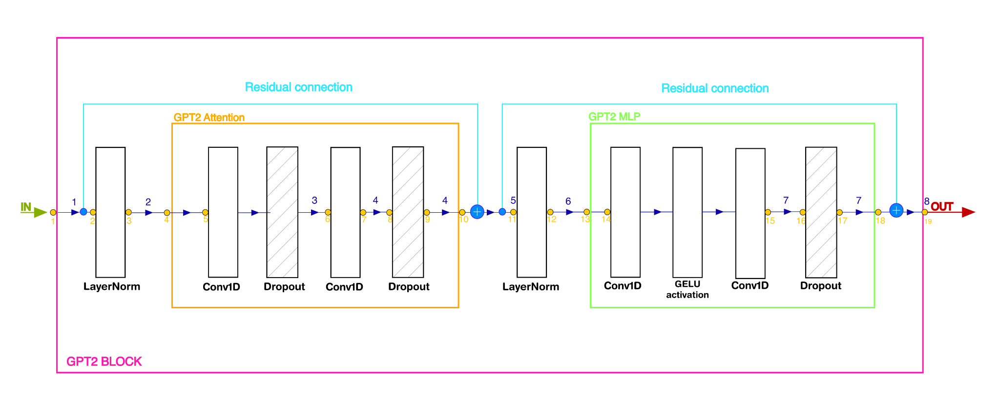
GPT-2 Decoder Block

Slide 9

Notes:
Not sure about it. If we should keep this animation or not,

Slide 10
Technical Approach
Part I: Token representations
Part II: Next token generation

Slide 11
Part I: Token representations
Goal: Gain insights into the transformations of the token representations throughout the GPT2 model
Strategy:
Collect intermediate token representations from different points throughout the model
Calculate pairwise token distances
Investigate distribution of token distances to last token
Compute intrinsic dimension at each stage

Slide 12
Data acquisition & preprocessing
data = [] # in/outputs
modules = [] #module names
def hook(module, input, output):
data.append(input[0].detach().numpy().squeeze())
modules.append(str(module))
data.append(output[0].detach().numpy().squeeze())
modules.append(str(module))
Step 1: Extract token representations
Define hook function to save module inputs and output
Attach to all modules & collect data
hook_handles = []
for module in model.modules():
handle = module.register_forward_hook(hook)
hook_handles.append(handle)
input_ids = tokenizer.encode(prompt, return_tensors="pt")
# Pass the input through the model (this triggers the hooks)
with torch.no_grad():
model(input_ids)

Slide 13
Step 2: Filter by shape
Nr. of tokens x embedding dimension
Step 3: Remove duplicates
only 7 datasets per decoder block
88 total

Slide 14
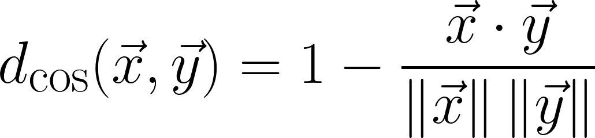
Token distances
Calculate the pairwise Cosine Distance between token representations:
Visualise the pairwise distance between tokens as heatmaps for short input prompt
Investigate distribution of distances to last token in input sequence:
Use 4 input prompts of ~800 token length for comparison
Extract distances to last token
For each module, perform KDE of distances

Slide 15
Intrinsic dimension
Minimum number of variables needed to accurately describe the important features
2NN-estimator:
PCA:
Estimates the intrinsic dimension based on the ratio of distances to the 2 nearest neighbours of each point
Compute intrinsic dimension for each module using the DADApy implementation of the 2NN-estimator
Perform PCA for each module input/output
Determine number of principal components needed to account for 90% of the variance

Slide 16
Part II:
Next token prediction
Pancakes are great for…
Pancakes are great for iced tea, but they're not as good for tea as they look.
The best way to make a pancake is to make a pancake out of a pancake.
The pancake is made from a pancake.
The pancake is made from a pancake.
The pancake is made
Goals:
Analyse token probabilities after last model layer
Investigate influence of parameters on generation process:
Temperature
Repetition penalty

Slide 17
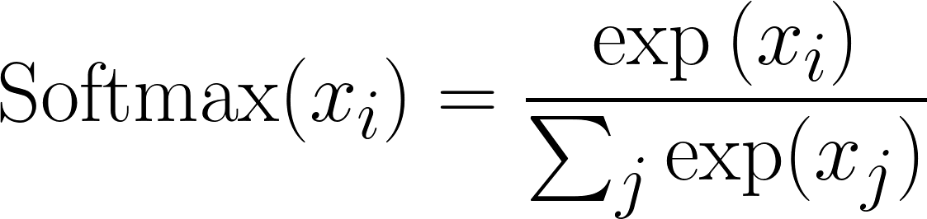
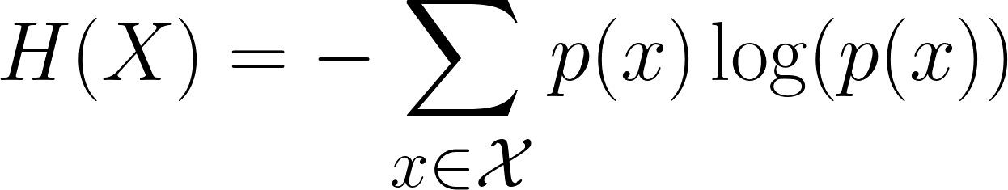
General Strategy
Define input sequence
Pass input through model
Extract logits
Apply softmax to get token probabilities
Select next token & append to sequence
Repeat 2.-6. with new sequence
Token selection:
Directly select token with highest probability
Investigate probability distribution of 50 most probable tokens
Calculate Shannon entropy from token probabilities
input_text = "Pancakes are great for "
input_ids = tokenizer.encode(input_text,
return_tensors="pt")
#selects token with highest probability
next_token_id = torch.argmax(probs, dim=-1)
with torch.no_grad():
outputs = model(input_ids)
# Get the logits for the last token
logits = outputs.logits[:, -1, :]
# Convert logits to probabilities
probs = torch.softmax(logits, dim=-1)
Select token randomly based on probability distribution
# sample from the probability distribution
next_token_id = torch.multinomial(probs,
num_samples=1)
Notes:
Note: this is animated and displayed consecutively, so don’t worry about the things on top of each other on the right :)

Slide 18
Output generation parameters
Temperature:
Repetition penalty:
# Apply temperature scaling
logits = logits / temperature
# Apply repetition penalty
if len(output_ids[0]) > 1:
for token_id in set(output_ids[0].tolist()):
probs[0, token_id] /= repetition_penalty
High temperature > 1:
decrease logits magnitude
softer probability distribution after softmax
Low temperature < 1:
increase logits magnitude
Sharper probability distribution
Go through each unique token in the sequence so far
divide corresponding probability by penalty (>1)
reduces likelihood of these tokens being generated again

Slide 19
Results & Conclusions

Slide 20
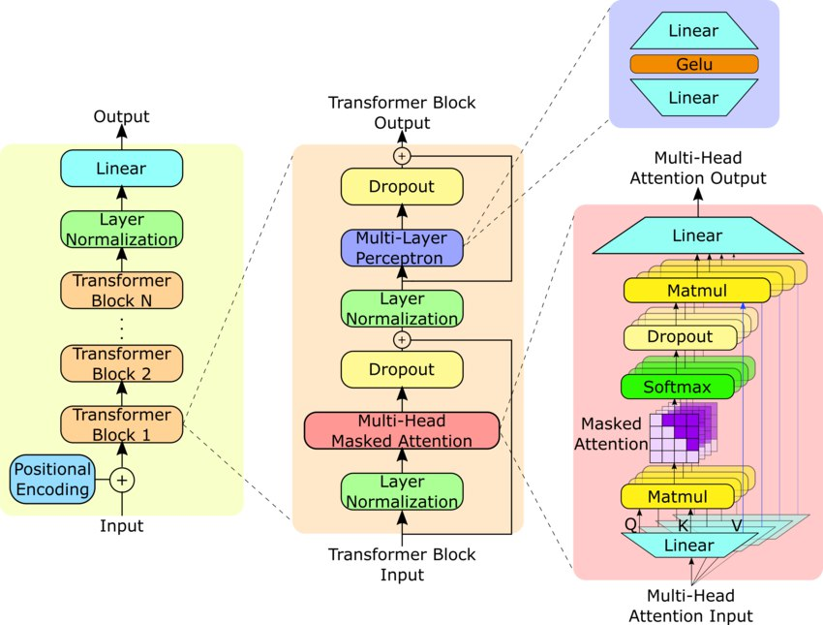
Part I: Token representations
Notes:
Don’t worry I’ll make this prettier

Slide 21
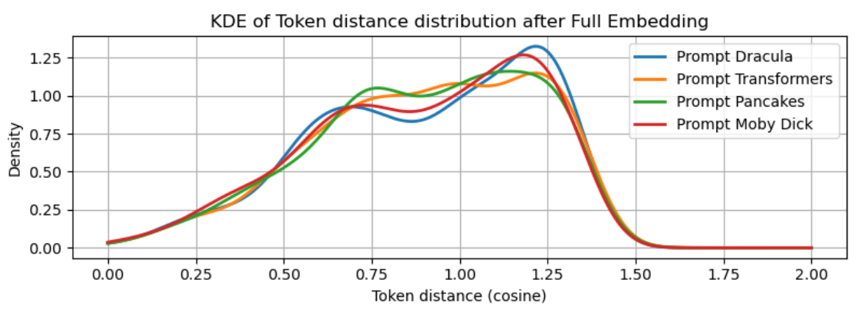
KDE distributions of token distances
After Full Embedding
Initial distributions are broad with gradual focus towards the last token.
the raw embedding space, before significant transformations

Slide 22
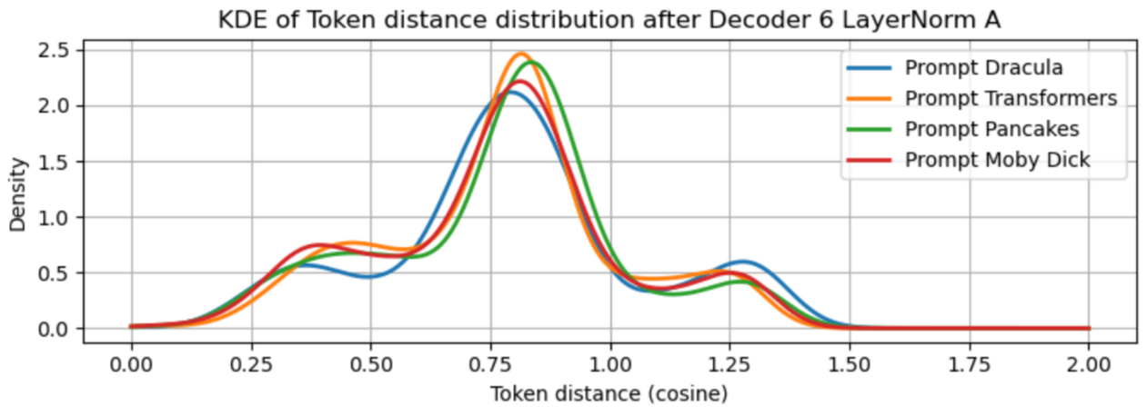
Layer Norm
more normalized and focused representation, the mean value around one.
Standardizes input distribution for stability and efficiency.
Improves the training efficiency and performance of the model.

Slide 23
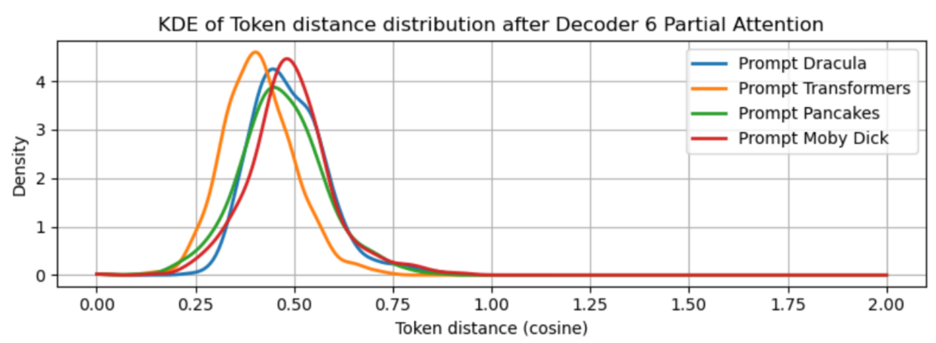
Partial Attention
Values move closer together, multi-peak structures reduce.
Convolution aggregates local information, smoothing the distribution.

Slide 24
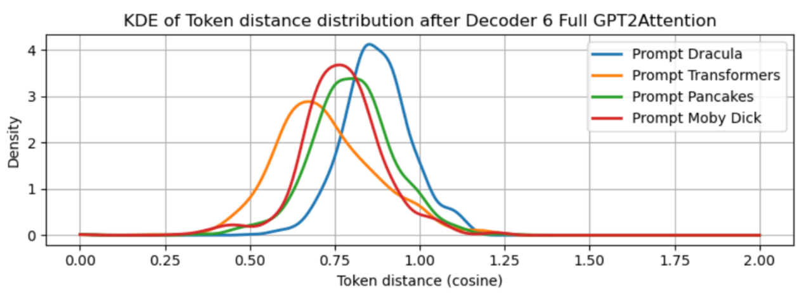
Full GPT2 Attention
Multi peak pattern, or variations between prompts highlight the model's adaptability to different input contexts.
sharper focus on the last token is crucial for predicting subsequent tokens accurately.
Self-attention reweighs token importance based on context, capturing dependencies.

Slide 25
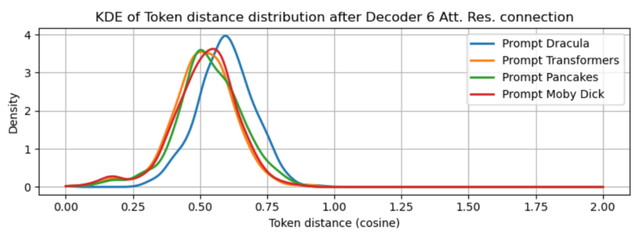
Att. Residual Connection
The residual connection adds stability, ensuring the output remains close to the input with minor adjustments.
The slight shifts and increased peak density indicate the integration of the attention output without drastic alterations.

Slide 26
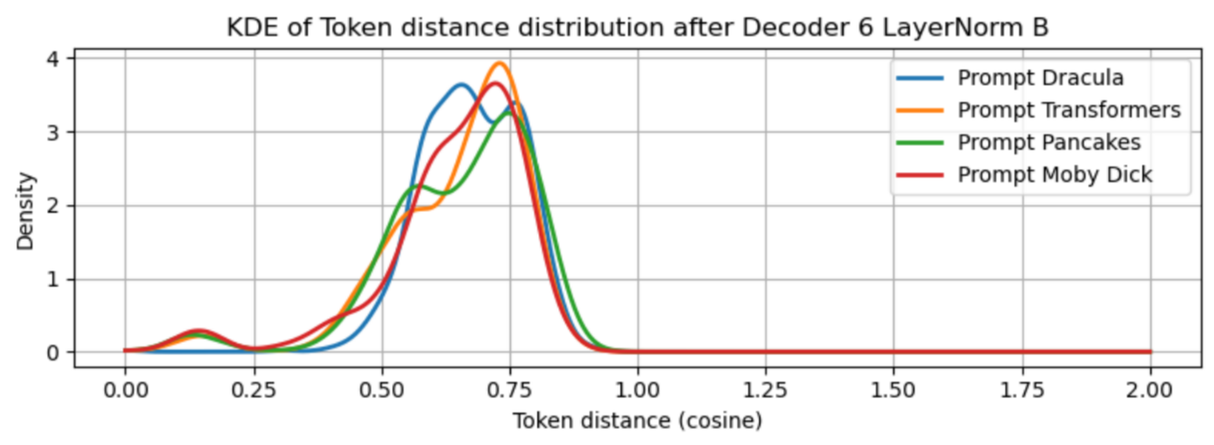
2nd LayerNorm
The second layer normalization in the MLP block introduce more variation and complexity.
spreading out the values and introducing new peaks, reflects the model's attempt to capture more intricate patterns in the data.

Slide 27
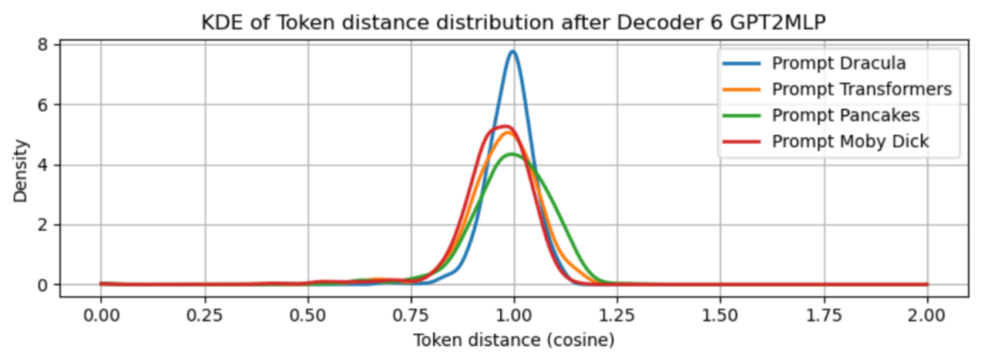
GPT2 MLP
The MLP block processes the inputs to generate a more regularized output, often centering around a standard value like 1
the differentiation between prompts indicates that the model is fine-tuning its output based on specific input characteristics.

Slide 28
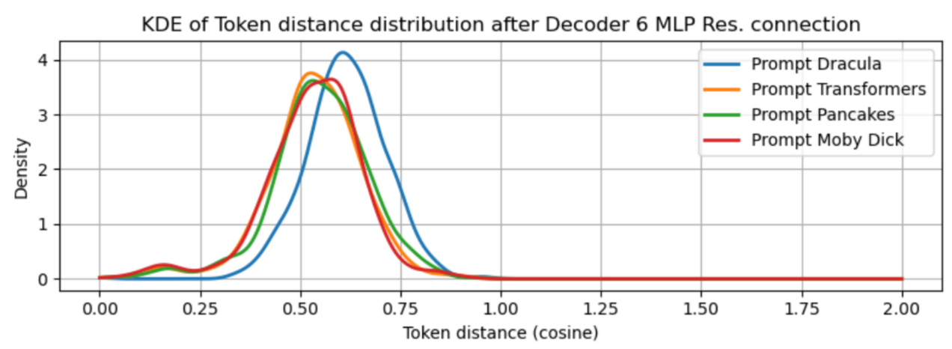
MLP Res. Connection
Initially, the residual connection ensures stability, with the output staying close to the input.
As the layers progress, the influence of the MLP becomes more apparent, leading to more significant changes in the distribution, which shows the model's deeper understanding and processing of the input data.

Slide 29
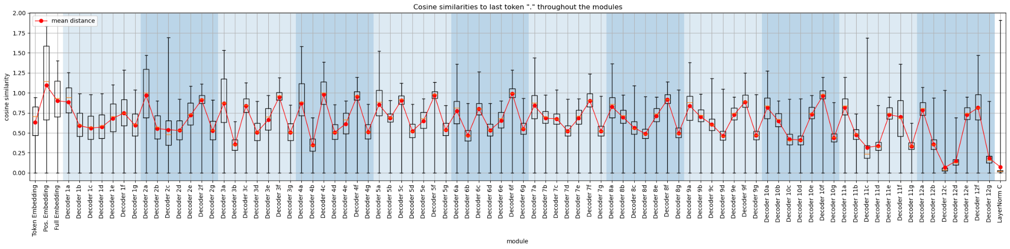
Distance evolution throughout the modules

Slide 30
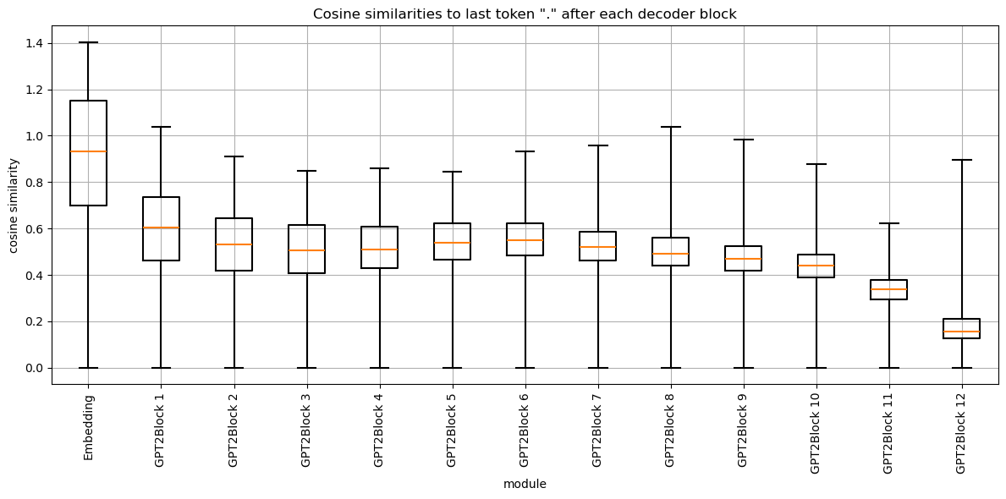
Distance evolution throughout the decoder blocks
Notes:
Distribution Trends Across Multiple Blocks:
Early Blocks
Observation: Minor changes, maintaining broad distributions.
Reason: Initial layers focus on capturing basic token relationships.
Middle Blocks
Observation: More noticeable shifts towards meaningful peaks, multi-modal distributions.
Reason: Mid-layer transformations capture more complex dependencies and relationships.
Late Blocks
Observation: Highly focused distributions, strong peaks at specific values, often near the last token.
Reason: Final layers refine the representation to focus on generating the next token with high precision, based on the entire context.

Slide 31
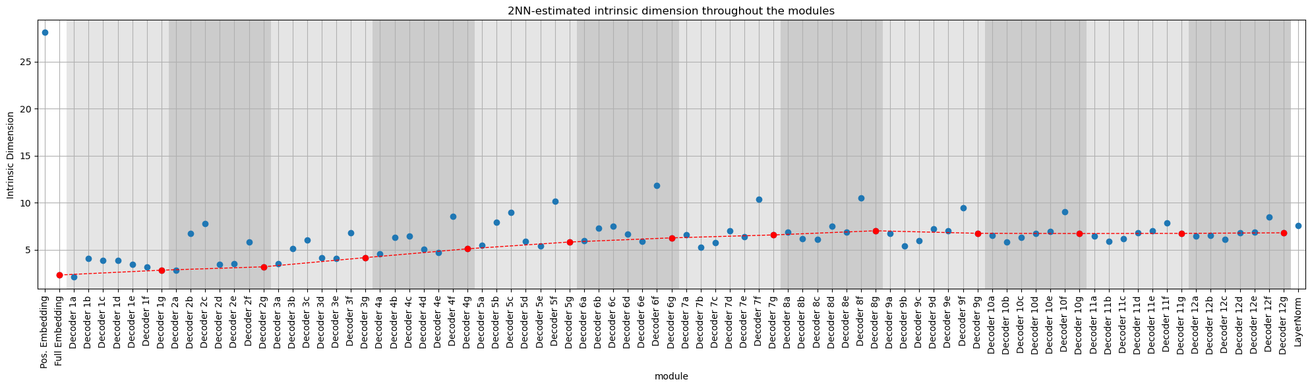
Intrinsic Dimension Analysis

Slide 32
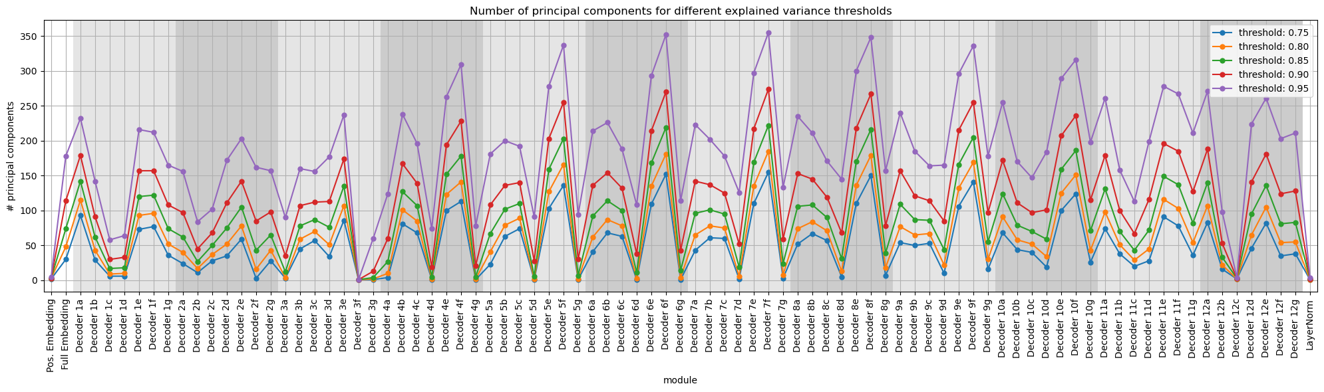
Principal Component Analysis for different thresholds

Slide 33
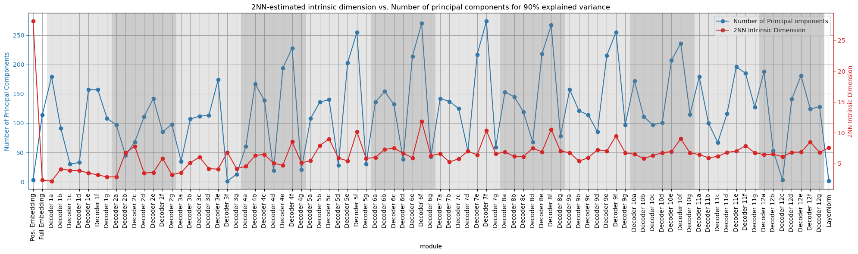
Comparison of 2NN and PCA

Slide 34
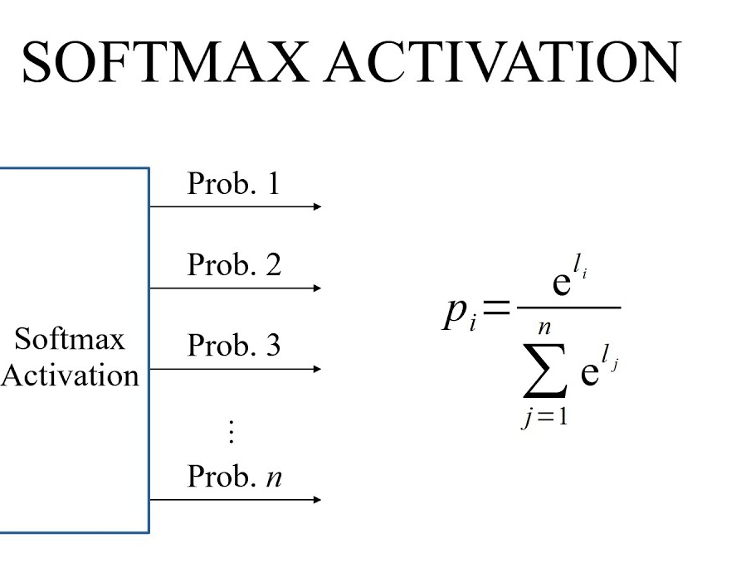
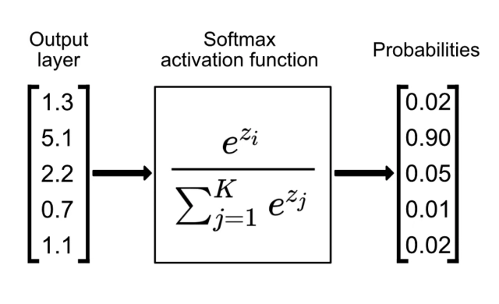
Part II:
Next token generation
Logits of next token
By most probable token
By multinomial distribution
Entropies of the two methods
Effect of temperature
Effect of repetition penalty

Slide 35
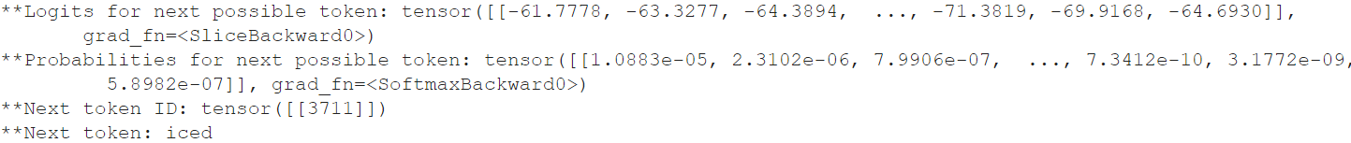
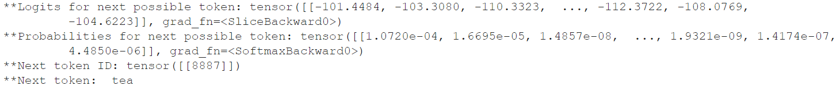
Logits to tokens

Slide 36
By most probable token
Input text: Pancakes are great for…
Generated text: Pancakes are great for a quick snack, but they're also great for a quick meal.
The best part about these pancakes is that they're made with a whole wheat flour. This means that they're gluten-free, and they're gluten-free.
The best part about these pancakes is that they're made with a whole wheat flour. This means that they're gluten-free, and they're gluten-free. The best part about these pancakes is that they're
Notes:
Don’t worry I’ll make this prettier

Slide 37
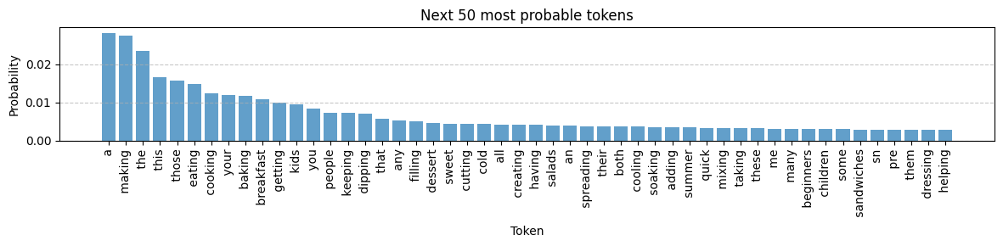
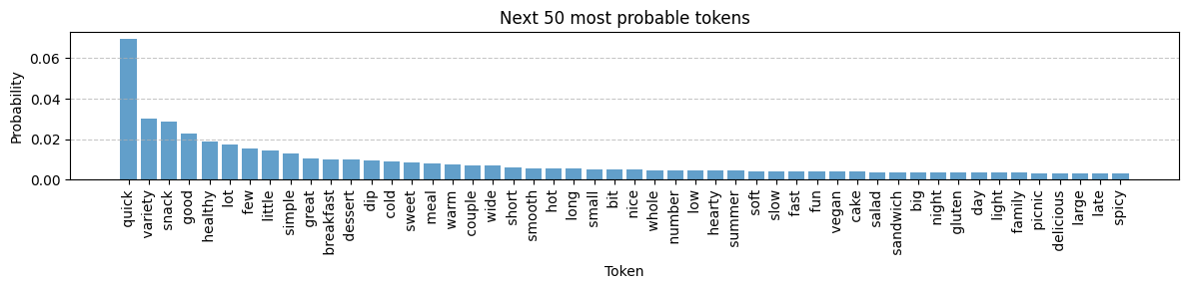
Generated: Pancakes are great for a…
Generated: Pancakes are great for a quick…

Slide 38
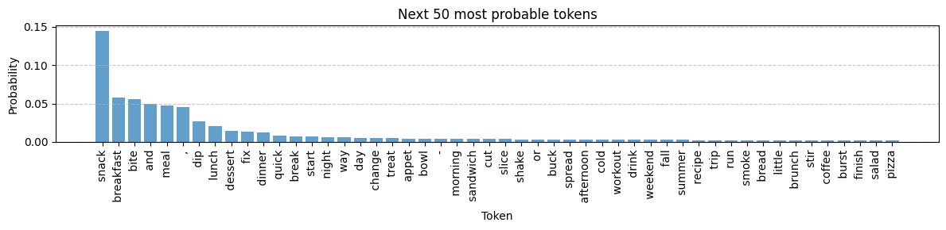
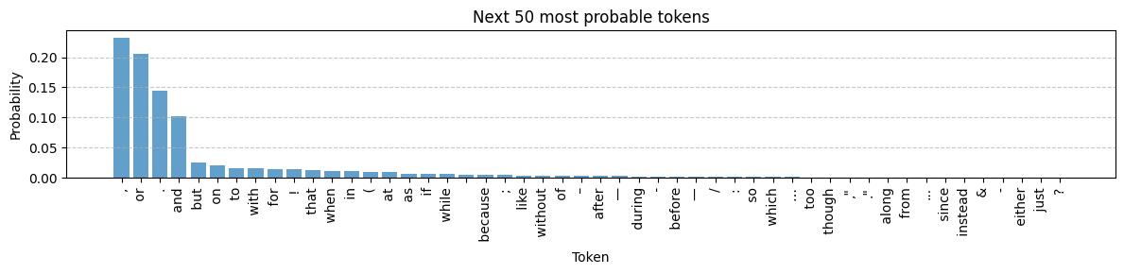
Generated: Pancakes are great for a quick snack…
Generated: Pancakes are great for a quick snack …

Slide 39
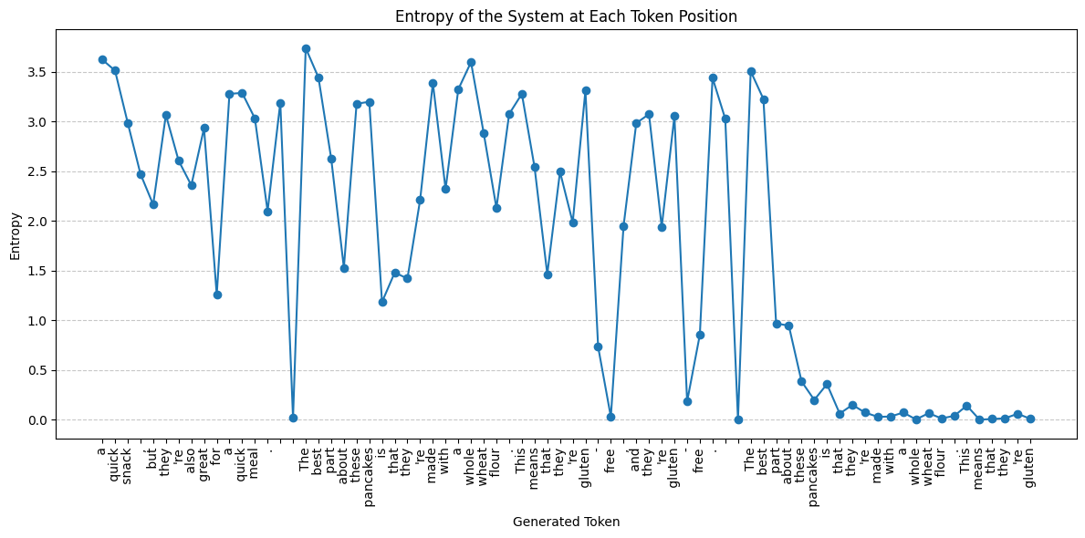

Slide 40
By multinomial distribution
Input text: Pancakes are great for…
Generated text: Pancakes are great for iced tea, but I prefer a thicker, sweeter version. These are fine too.
I've heard some people say that that's why it's called a "pang flavoring" but I've heard that it's the same thing as "oil flavoring". I'm not sure if you've heard of "oil flavoring" but I think
Notes:
Don’t worry I’ll make this prettier

Slide 41
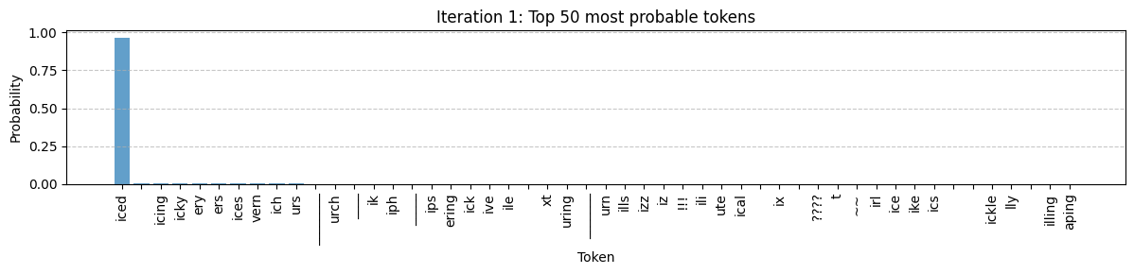
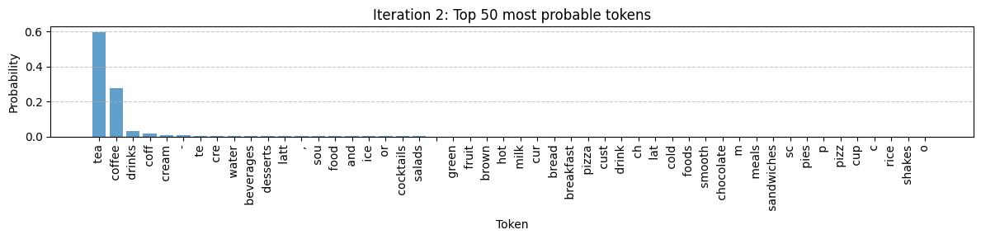
Generated: Pancakes are great for iced…
Generated: Pancakes are great for iced tea…

Slide 42
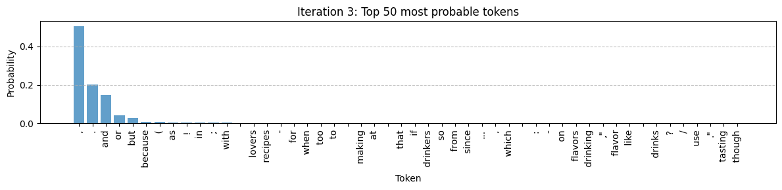
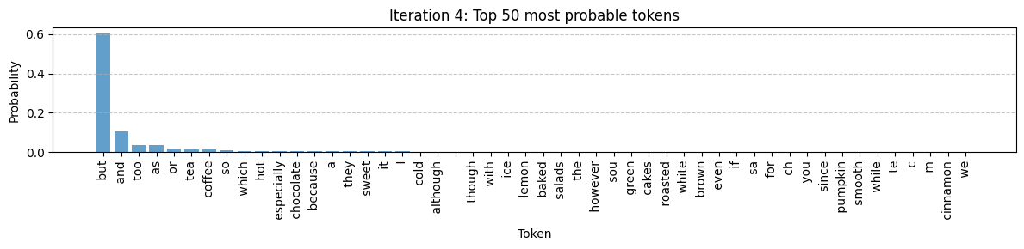
Generated: Pancakes are great for iced tea …
Generated: Pancakes are great for iced tea,…

Slide 43
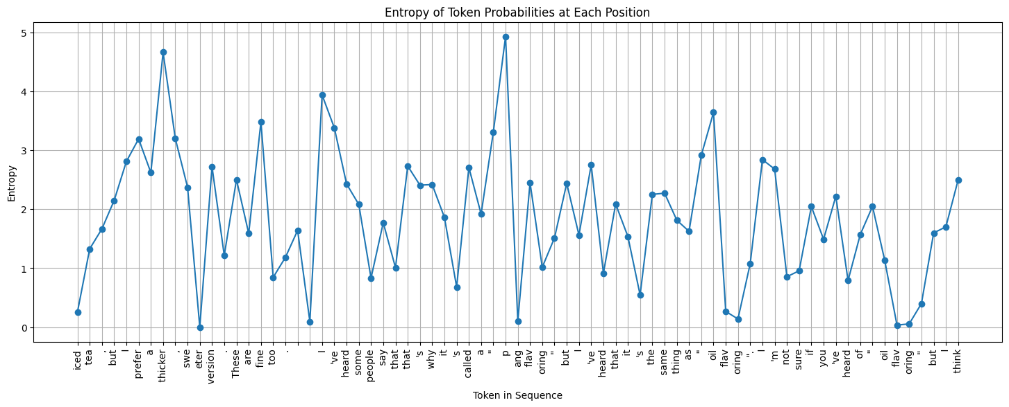

Slide 44
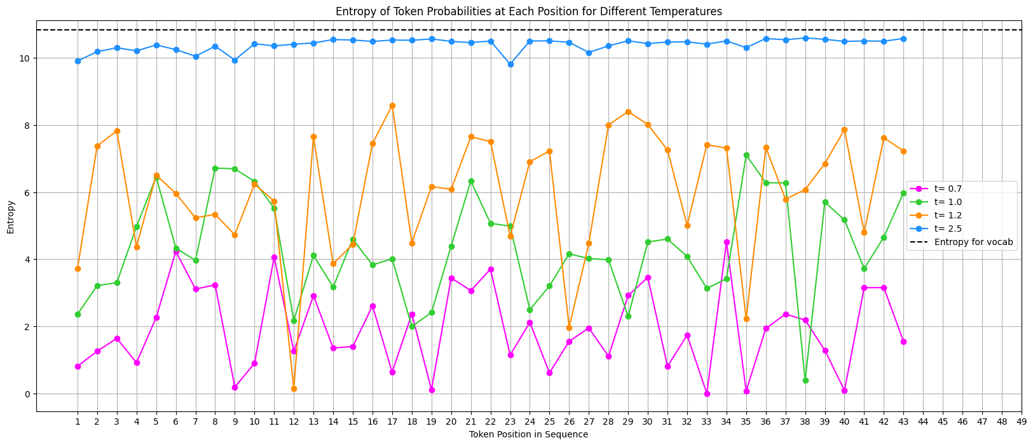
Changing the Temperature

Slide 45
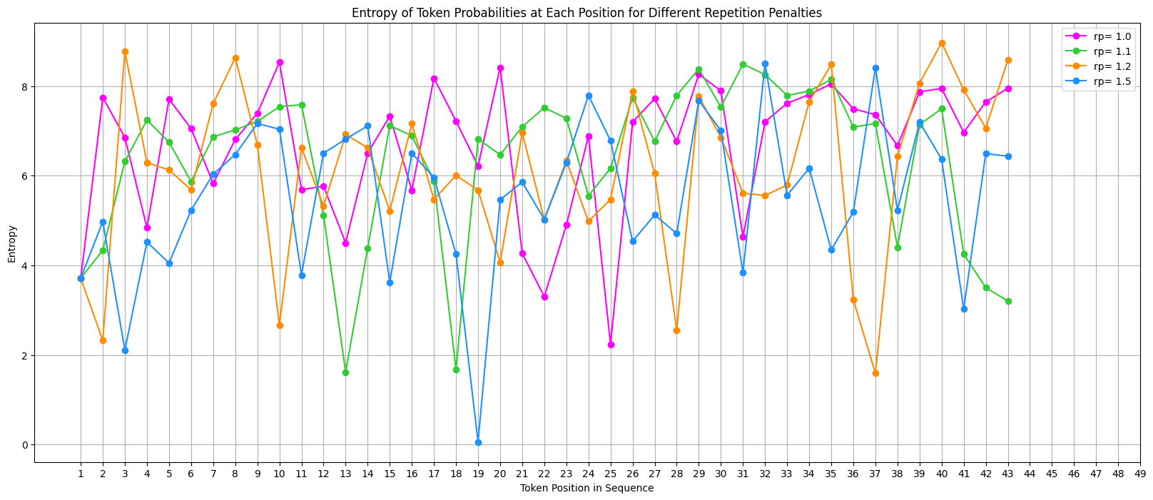
Changing the Repetition Penalty

Slide 46
Summary
Evolution of Token representations
Next Token Prediction
Analysed how different modules transform the token embedding vectors through their distances and intrinsic dimension
Observed how token embeddings are ultimately focused towards the last token in the input sequence
Changes are most prominent throughout the last decoder blocks
bias towards next token being a token already used
bias towards generation of first token in sequence to have the most options for being a non-ASCII
combination of temperature + repetition penalty affect entropy
repetition penalty itself does not affect entropy

Slide 47


Thank you for your (Multi-Head) Attention!

